Slide 1

Project Phase I Presentation Suitability Analysis and Estimation of Power for Siting Solar Power Plant in Pune Presented by Akash Solunke (BE22205) Darshan Satish Patil(BE22117) Varad Kulkarni(BE22159) Guided by Prof. Anjali Jagtap
Dept. of Electronics and Telecommunication
Hope Foundation’s
International Institute of Information Technology Hinjewadi Pune

Slide 2
Outline
Introduction
Literature survey
Gap Identification
Problem statement and Objectives
Proposed Methodology
Requirement analysis
Impact analysis
Professional Ethical practices to be followed
System Implementation
Results and discussion
Conclusions and Future Scope
References

Slide 3
Introduction
Fossils fuels are limited
So we need alternative resources
This study aims to provide a GIS based model for multi-criteria suitability analysis
This leads us to “ SUITABILITY ANALYSIS AND ESTIMATION OF POWER FOR SETTING SOLAR POWER PLANT IN PUNE"

Slide 4
Literature survey
List out work done by researchers with proper citation
Sr. No | Paper Name | Published By | Highlights
1. | Site Suitability Analysis of Solar Farm using AHP Technique | Mr. Ganesh Bhag- wan Chavan, Prof. V. Rajesh Chaudhary, Prof. S. S. Badhe | This paper incorporates Geoinformatics techniques to determine site suitability analysis for establishment of solar farms based on photovoltaic (PV) solar cell technology in the district of Pune, state of Maharashtra, India. By analyzing the data on various factors affecting the PV solar farm site suitability, one can map these factors according to different weightage linked to each factor and using Analytical Hierarchy Process (AHP) techniques.

Slide 5
Literature survey
List out work done by researchers with proper citation
Sr. No | Paper Name | Published By | Highlights
2. | GIS-Based Site Suitability Analysis for Solar Power Systems in Mongolia | Yosoon Choi, Pukyong National University | The paper aims to provide a GIS-based model for multi-criteria suitability analysis that can be employed in identifying the potential sites for photovoltaic power plants. The proposed model assisted in integrating a number of criteria relevant indicators that reflect the suitability of various parts of Kuwait for siting photovoltaic power plant.

Slide 6
Literature survey
List out work done by researchers with proper citation
Sr. No | Paper Name | Published By | Highlights
3. | Optimal Solar Plant Site Identification Using GIS and Remote Sensing: Framework and Case Study | Abdulaziz Alhammad , Qian (Chayn) Sun and Yaguang Tao,Geospatial Sciences, School of Science | Many countries have set a goal for a carbon neutral future, and the adoption of solar energy as an alternative energy source to fossil fuel is one of the major measures planned. Yet not all locations are equally suitable for solar energy generation. This is due to uneven solar radiation distribution as well as various environmental factors. This paper developed a spatial MCDA framework catering to the characteristics of the Al-Qassim region.

Slide 7
Literature survey
List out work done by researchers with proper citation
Sr. No | Paper Name | Published By | Highlights
4. | GIS-Based Assessment of Solar Energy Harvesting Sites and Electricity Generation Potential in Zambia | Mabvuto Mwanza, Koray Ulgen | Land and environment are some of limited nature resource for any particular country and requires best use. Therefore, for sustainable energy generation it is often important to maximize land use and avoid or minimize environmental and social impact when selecting the potential locations for solar energy harvesting. This paper presents an approach for identifying and determining the potential sites and available land areas for solar energy harvesting.

Slide 8
Literature survey
List out work done by researchers with proper citation
Sr. No | Paper Name | Published By | Highlights
5. | Land Suitability Investigation for Solar Power Plant Using GIS, AHP and Multi-Criteria Decision Approach: A Case of Megacity Kolkata, West Bengal, India | Bijay Halder , Papiya Banik, Hussein Almohamad Ahmed Abdullah Al Dughairi , Motrih Al -Mutiry , Haya Falah Al Shahrani and Hazem Ghassan Abdo | The site suitability map was developed using a pairwise comparison matrix and the weights were calculated for each criterion. The suitability map was divided into five categories, from not suitable to very highly suitable. A total of 474.21 km2 (10.69%) of the area was classified as very highly suitable whereas 249.54 km2 (5.62%) area was classified as not suitable because of the water area and east Kolkata wetland. A total of 1438.15 km2 (32.43%) of the area was classified as highly suitable for a solar power plant. The Kolkata megacity and water body locations were identified as moderate to not suitable sites.

Slide 9
Gap Identification
Solar power plant can be set up at any place but
Suitable place needs to be discovered to get optimal output
Suitability analysis needs to be done to find the best location

Slide 10
Problem statement and Objectives
Problem statement
Suitability analysis and power estimation for siting solar power plant in Pune
Objectives
To do suitability analysis and find suitable site to establish solar power plant in Pune
Maps Required will be: Solar Radiation, Land Use Land Cover, Slope, Aspect, Transmission Line, Rail, Road, Water Line and Water bodies maps.

Slide 11
Proposed Methodology
Proposed Methodology with proper block diagram
Collect the map data:
Solar irradiance, road, rail, transmission lines, water lines, water bodies.
Select Area for the Analysis
Collect the satellite images of the selected area(Sentinel)
Generation of Maps: LULC, Solar Radiation, Slope, Aspect, Transmission line, Rail, Road, Water Line, Water Bodies
Generate the final suitable site map
Analysis using AHP, weight matrix (in ArcGIS)

Slide 12
Proposed Requirement Analysis
Satellite images of Pune district
Maps: Solar radiation, LULC, Slope, Aspect, Transmission Line Rail, Road, Water Line, Water Bodies.
GIS software [ArcGIS].

Slide 13
Impact analysis
Positive Impact of project on society:
• Reduced burden on fossil fuels/exhaustible natural resources
• Potentially reduce pollution
Negative Impact of project on society:
• Massive initial investments required

Slide 14
Impact analysis
Impact of project on environment
Positive Impact of project on environment:
• Reduced dependency on exhaustible natural resources
• Clean energy
• Unlimited source of energy
Negative Impact of project on environment:
• Weather Dependent

Slide 15
Professional Ethical practices to be followed
The study done has not been copied from other sources
Appropriate credits are provided to the concerned party whose resources are referred in the study
Conflict of interest was resolved using proper discussions

Slide 16
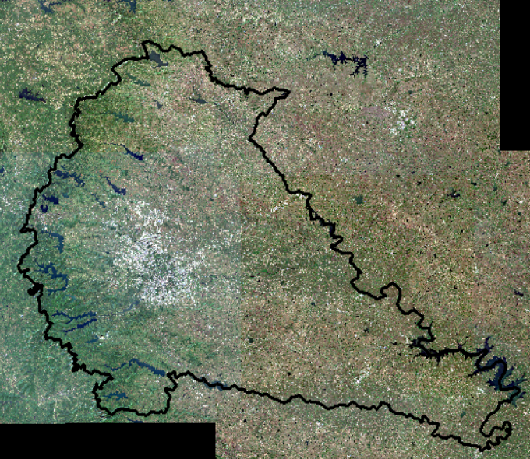
System Implementation
Sentinel data of Pune district is collected along with boundary map.
Fig. Pune District boundary map
Source: https://scihub.copernicus.eu/dhus/#/home

Slide 17
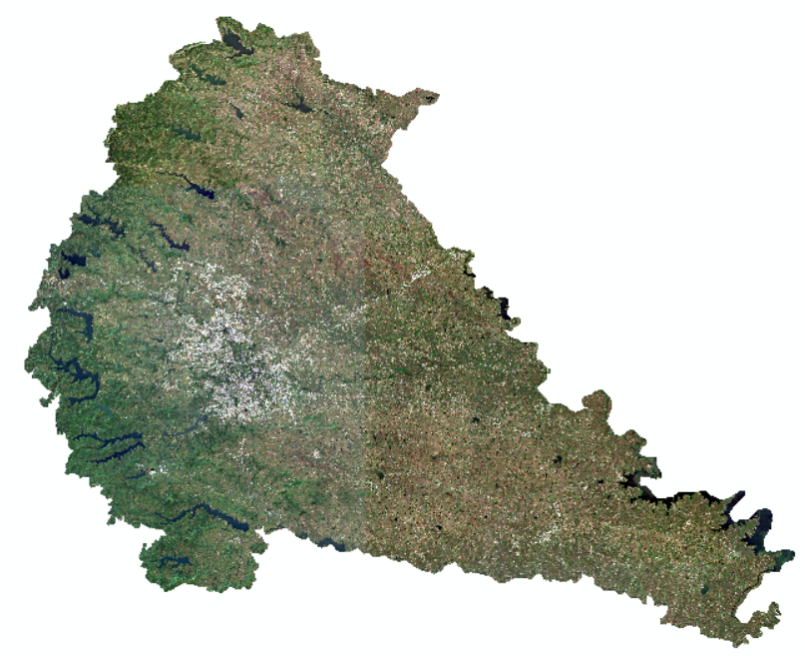
System Implementation
Preprocessing of the data is done.
Fig. Clipped Pune from the sentinel data

Slide 18
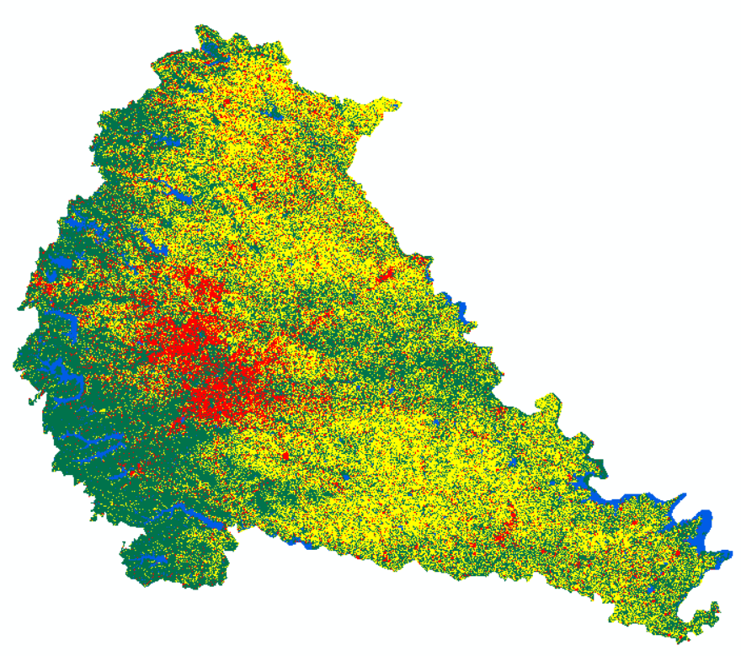
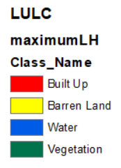
Land Use Land Cover map is generated from the preprocessed data using maximum likelihood algorithm.

Slide 19
System Implementation
The LULC map tells about the percentage of built up area, barren land, water bodies, agriculture and vegetation covered in the Pune district.
Class Name | Area (in Sq Km) | Percentage
Barren Land | 5917.6623 | 37.95
Built Up | 1799.1103 | 11.54
Vegetation | 7353.6713 | 47.16
Water | 522.5976 | 3.35
Grand Total | 15593.0415 | 100

Slide 20
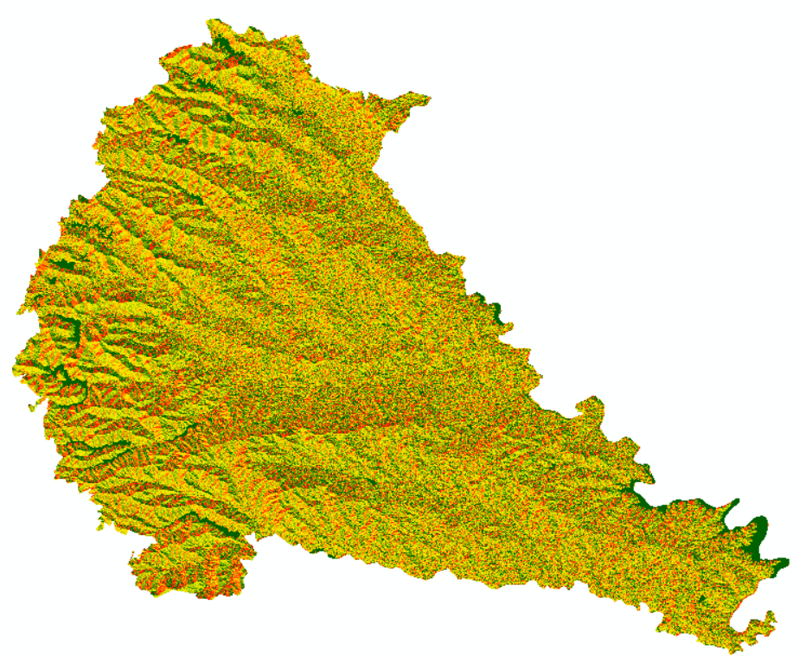
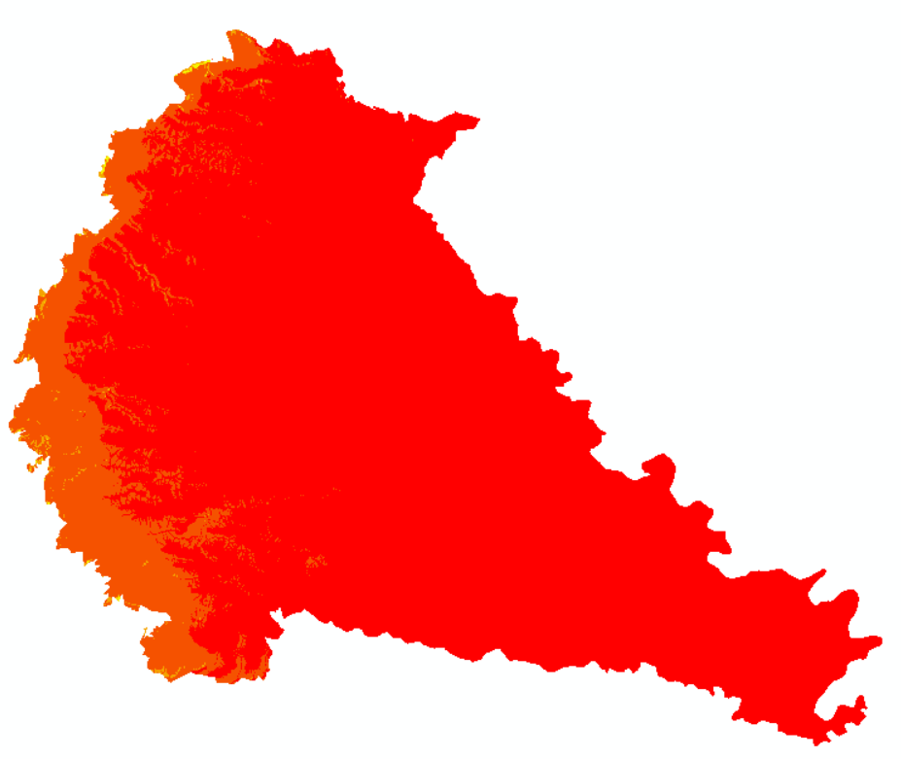

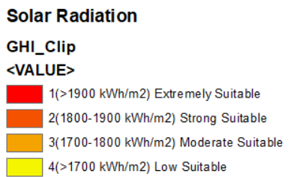
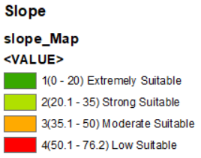
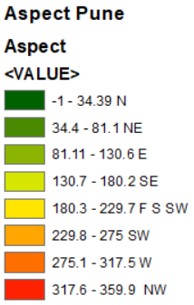
Other Maps are produced/ collected from sources which is used for the suitability analysis.
Source: (DEM) https://bhuvan-app3.nrsc.gov.in/data/download/index.php

Slide 21
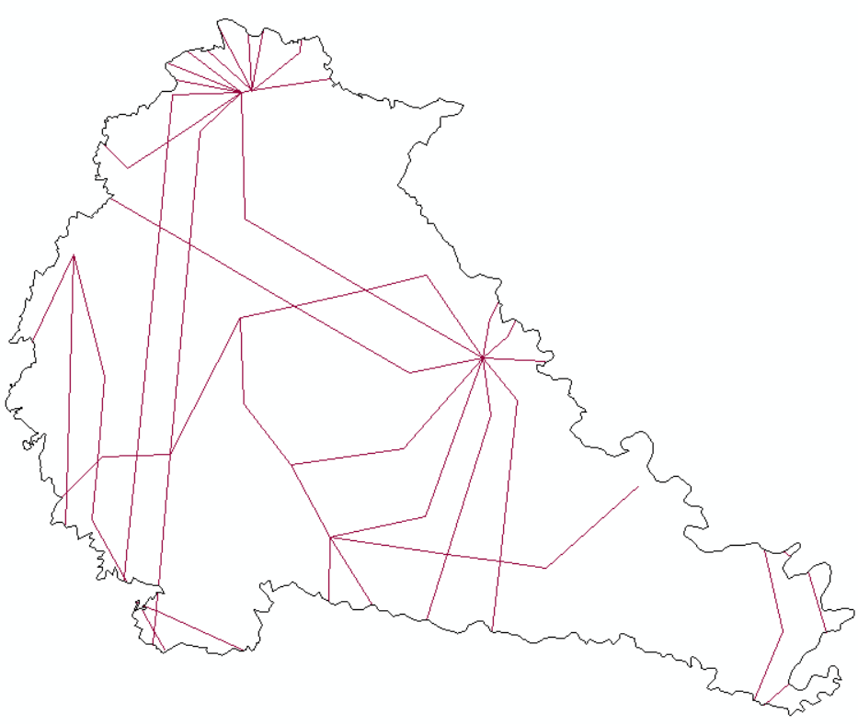
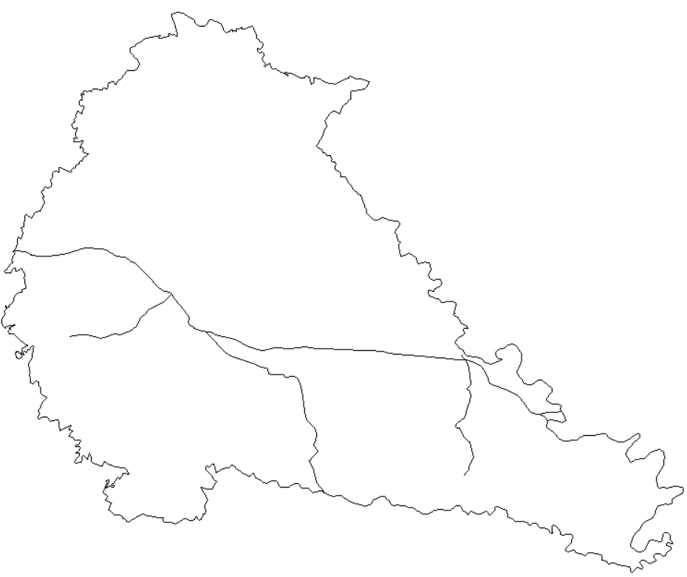
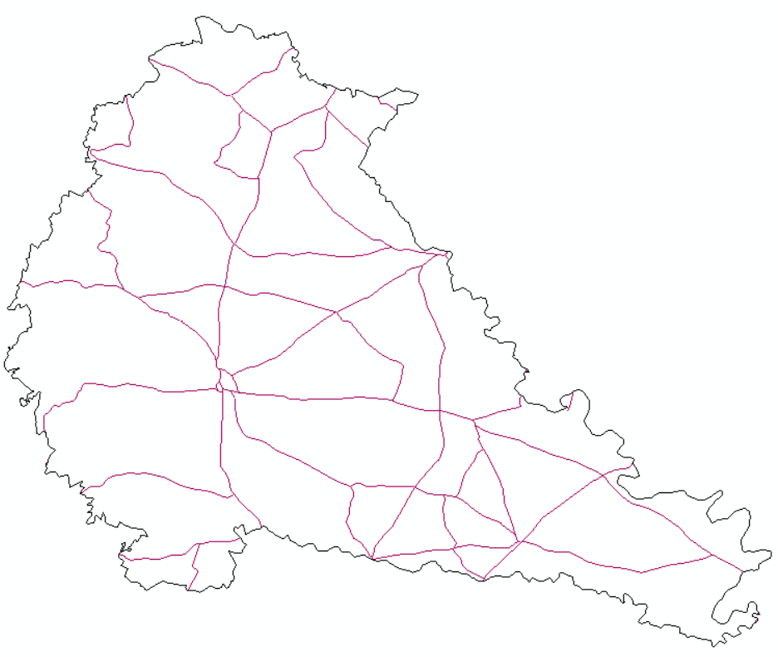
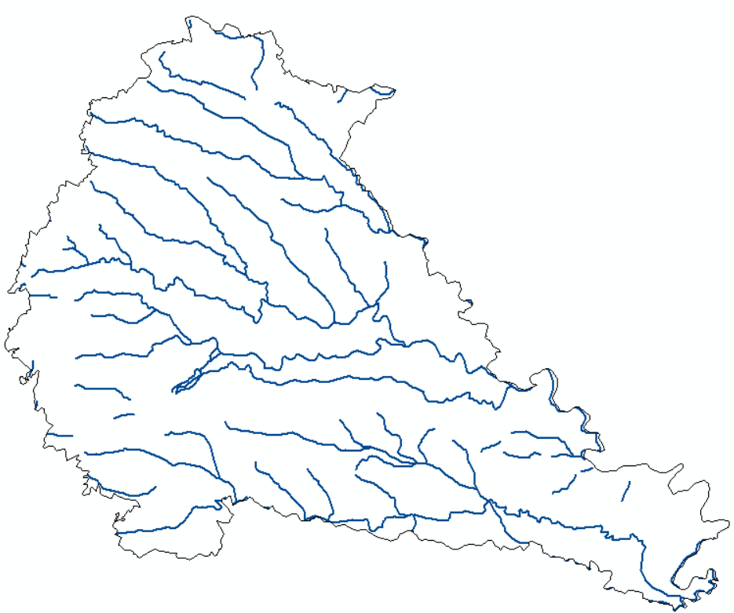
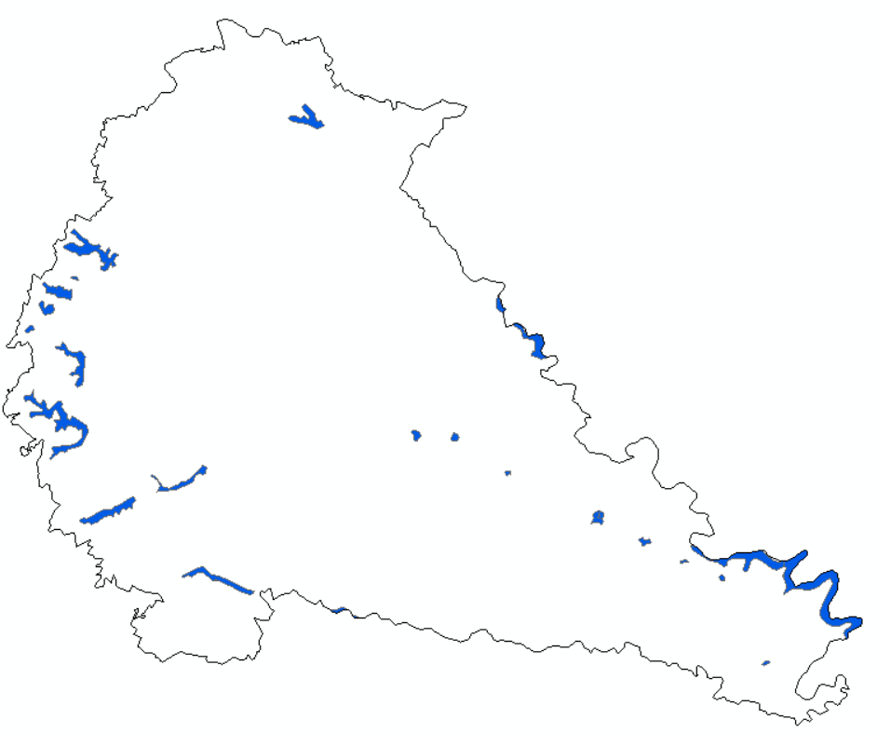
Fig. Pune Transmission Line Map
Fig. Pune Railway map
Fig. Pune Road Map
Fig. Pune Water Line Map
Fig. Pune Water Bodies Map
Source: https://www.diva-gis.org/gdata

Slide 22
System Implementation
Using the AHP calculator, we get the weighted values for each map, used to get the final suitability map.
Map | Value
1. Solar Radiation | 25.5
2. Land Use Land Cover | 17.18
3. Slope | 7.37
4. Aspect | 8.09
5. Distance from Transmission Line | 11.61
6. Distance from Railway | 8.07
7. Distance from Road | 7.93
8. Distance from Water Line | 7.20
9. Distance from Water Bodies | 7.09

Slide 23
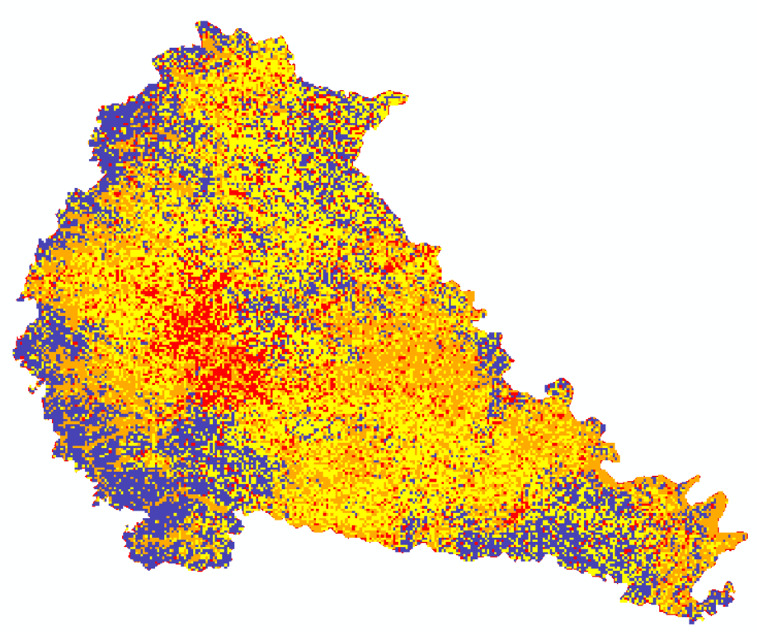
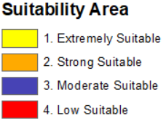
Results and discussion
Fig. Pune District Solar Suitability Map

Slide 24
Results and discussion
Sr. No | Particulars | Pixel Count | Percentage | Area(Km2)
1 | Extremely Suitable | 13853 | 37.63 | 5867.66
2 | Strong Suitable | 9633 | 26.18 | 4082.26
3 | Moderate Suitable | 9236 | 25.08 | 3910.74
4 | Low Suitable | 4092 | 11.11 | 1732.38
 | Total Count | 36814 | 100 | 15593.04

Slide 25
Results and discussion
The Suitability map generated presents us with the following results that:
The extremely suitable area was of total 5867.66 Km2.
The strong suitable area was of total 4082.26 Km2.
The moderate suitable area was of total 3910.74 Km2.
The low suitable area was of total 1732.38 Km2.
The values generated might contrast to the actual data present and if needed needs to be re-worked upon.

Slide 26
Conclusions and Future Scope
Conclusion
We conclude that upto 37% of Pune district area is highly suitable for setting up solar power plant
And approx. 11% area of Pune district is low suitable for solar power plant
The values generated might deviates from the actual values and needs to be cross verified
Hence, if needed some re processing needs to be done to get more accurate results
Future Scope
Further more discovery can be done using the satellite images.

Slide 27
References
Site Suitability Analysis of Solar Farm using AHP Technique [https://drive.google.com/drive/folders/19s1eCOeSzSLmch4vpMgmvpfDvflv8cCP?usp=sharing]
https://www.researchgate.net/publication/351033823_GIS-Based_Site_Suitability_Analysis_for_Solar_Power_Systems_in_Mongolia?enrichId=rgreq-2aee97677d37b3753fe433bc9ce4c97e-XXX&enrichSource=Y292ZXJQYWdlOzM1MTAzMzgyMztBUzoxMDE1MDMzNzU2NjcyMDA0QDE2MTkwMTQzMTQ5OTI%3D&el=1_x_3&_esc=publicationCoverPdf
https://www.researchgate.net/publication/357563972_Optimal_Solar_Plant_Site_Identification_Using_GIS_and_Remote_Sensing_Framework_and_Case_Study
https://www.researchgate.net/publication/350458295_GIS-Based_Assessment_of_Solar_Energy_Harvesting_Sites_and_Electricity_Generation_Potential_in_Zambia/link/60618bcc92851cd8ce74c05f/download
https://www.mdpi.com/2071-1050/14/18/11276

